Slide 1
Employee Data Analysis using Excel
STUDENT NAME: Bebinal Mary J
REGISTER NO:312210154 (asunm136322ca05)
DEPARTMENT:B.com(computer applications)
COLLEGE: Valliammal college for

Slide 2
PROJECT TITLE
Employee attrition analysis using Excel dashboard

Slide 3
AGENDA
Problem Statement
Project Overview
End Users
Our Solution and Proposition
Dataset Description
Modelling Approach
Results and Discussion
Conclusion
3/21/2024 Annual Review

Slide 4
PROBLEM STATEMENT
1. **Problem Statement **
2. **Data Collection**
3. **Data Preprocessing**
4. **Exploratory Data Analysis (EDA)**
5. **Dashboard Design**
6. **Dashboard Implementation**
7. **Result Analysis and Interpretation**
8. **Recommendations**
9. **Stakeholder Communication**

Slide 5
PROJECT OVERVIEW
1. **Project Objective**
2. **Data Collection**
3. **Data Preprocessing**
4. **Exploratory Data Analysis (EDA)**
5. **Dashboard Design**
6. **Visualization and Insights**
7. **Recommendation Development**
8. **Project Deliverables**
9. **Communication and Reporting**
.

Slide 6
WHO ARE THE END USERS?
:
1. **HR Managers**
2. **Department Heads**
3. **Senior Leadership/Executives**
4. **Talent Management Teams**
5. **Compensation and Benefits Teams**
6. **Employee Engagement Teams**
7. **Data Analysts**
8. **Recruitment Teams**
an

Slide 7
OUR SOLUTION AND ITS VALUE PROPOSITION
### **Our Solution**
1. **Interactive Excel Dashboard**
2. **Comprehensive Data Analysis**
3. **Predictive Insights**
4. **Customizable Filters**
### **Value Proposition**
1. **Data-Driven Decision Making**
2. **Cost-Effective Solution**
3. **Actionable Insights**
4. **Improved Employee Retention**

Slide 8
Dataset Description
1. **Employee Demographics**
2. **Department and Job Role**
3. **Tenure and Experience**
4. **Salary and Compensation**
5. **Performance Ratings**
6. **Job Satisfaction and Engagement Scores**
7. **Attrition Status**
8. **Leave and Absenteeism Data**
9. **Training and Development**
10. **Work-Life Balance Indicators**

Slide 9
THE "WOW" IN OUR SOLUTION
1. **Real-Time Data Visualization**
2. **Interactive Filters and Slicers**
3. **User-Friendly Interface**
4. **Customizable Dashboards**
5. **Automated Data Updates**
6. **Predictive Attrition Modeling**
7. **In-Depth Drill-Down Analysis**
8. **Actionable Insights at a Glance**
3/21/2024 Annual Review
9

Slide 10
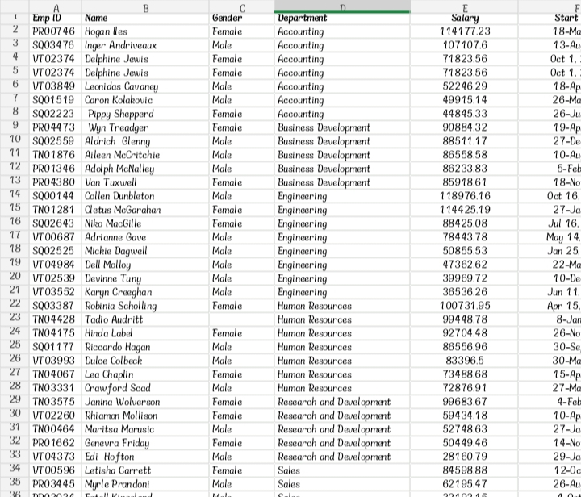
MODELLING
10

Slide 11
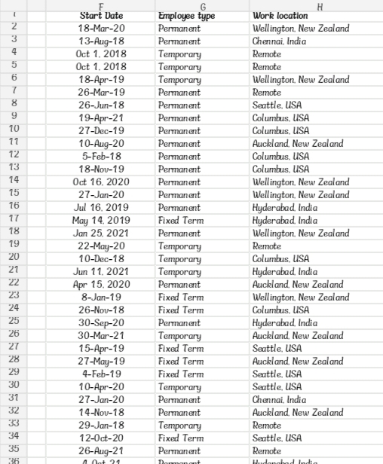
RESULTS
11

Slide 12
conclusion
1. **Summary of Key Insights**
2. **Impact on Business Decisions**
3. **Recommendations for Reducing Attrition**
4. **Future Enhancements**
5. **Final Thoughts on Employee Retention Strategies**

